Slide 1
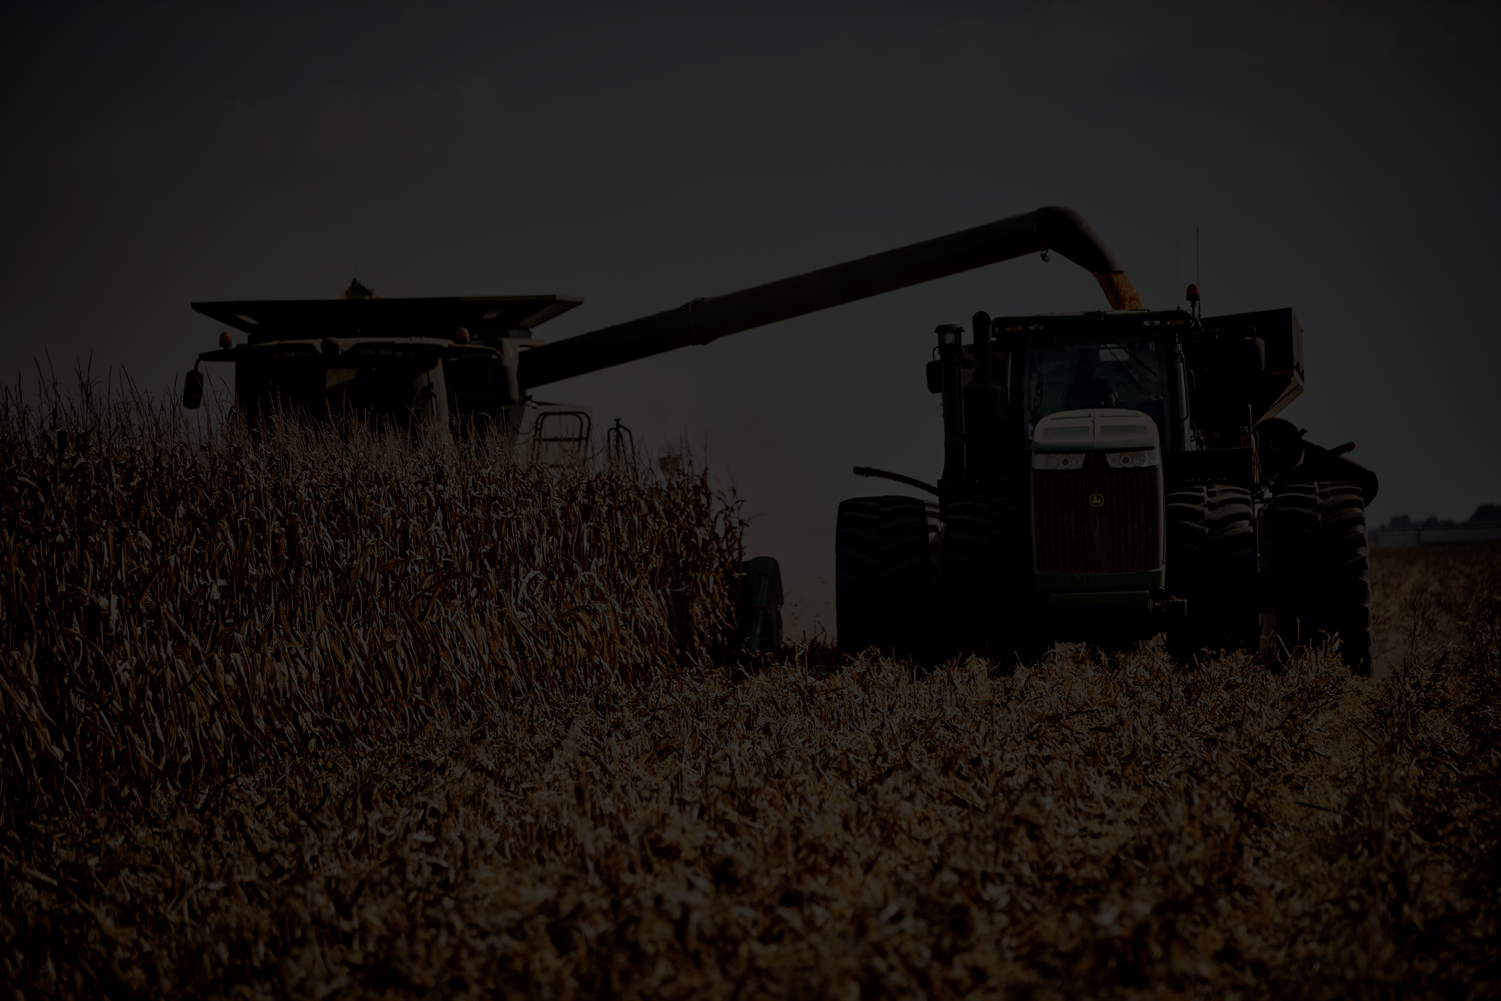
SmartFarms: Crop and Livestock Management System
Kojo (kojo)
Zain (zainmirza)
Tausif (tausifi21)
Alex (alexla)
Chris (chrislam)
Gerald (gerald961)

Slide 2
Brief Introduction…Why SmartFarms?
Motivation:
The agriculture industry is increasingly adopting smart technology to optimize farming practices
Background:
Our Smart Farm Management System is essential, as it helps farmers make data-driven decisions, automate tasks, and enhance overall farm efficiency.
Necessity:
Optimize farming practices
Increase crop & livestock yields
Reduce resource usage
Enhance overall productivity

Slide 3
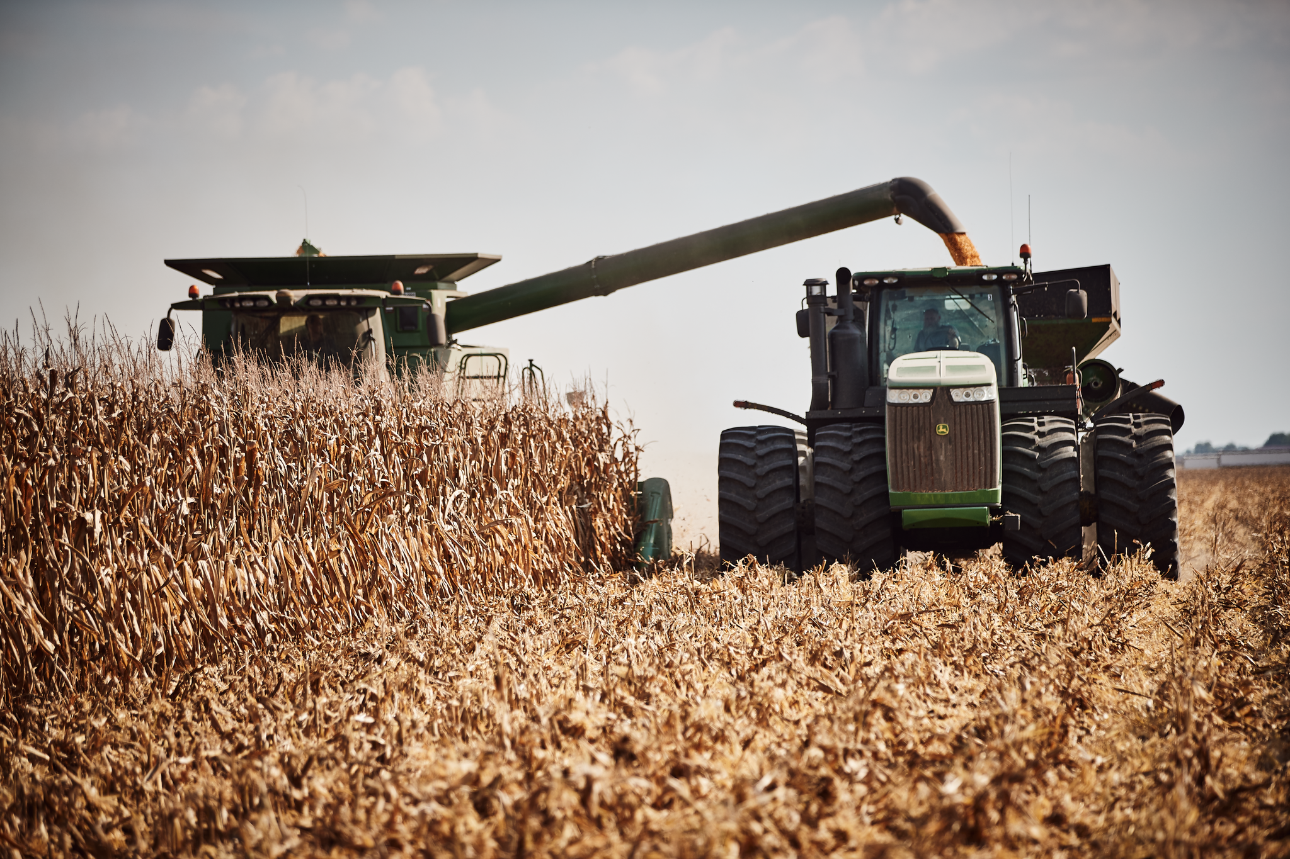
Feature #1 - Gerald - harvest
Functional
Crop Yield Prediction: use data to predict yield
Crop Harvest Planning
Harvest Inventory management
Auto Harvesting Management - autonomous farm vehicles
Crop rotation planning
Non Functional: Availability
24/7 availability
Offline capability
Additional features to minimize downtime.

Slide 4
Feature #2 - Alex - pest, predators and emergency system
Functional
Pest Detection and Monitoring
Predator monitoring and prevention (Motion sensors for pest, predators)
Emergency Response System - i.e. natural disasters, disease outbreaks, predator attack
Non-functional : Scalability
Changing requirements to the land
New technologies being introduced

Slide 5
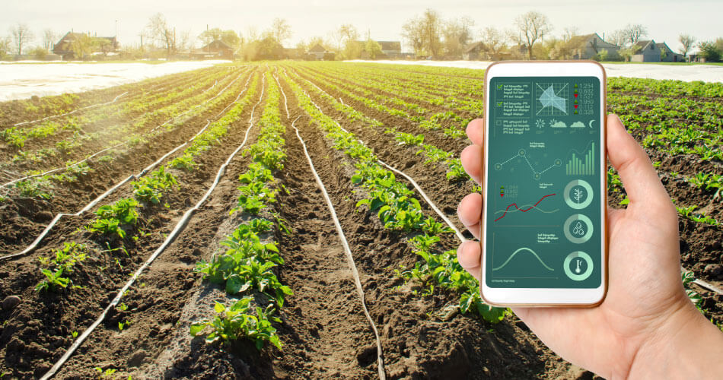
Feature #3 - Chris - crop and livestock wellbeing
Functional:
Livestock health tracking (child bearing, diseases)
Livestock maturity tracking (kill the cow/chicken, collect the eggs)
Automatic feeders for livestock
Livestock yield prediction (ounces of beef, gallons of milk)
Nonfunctional: Usability
Easy to comprehend and use GUI
Mobile app for fast and easy access
Support section with FAQ and agent support

Slide 6
Feature #4 - Tausif - soil maintenance
Functional:
Soil pH, Nitrogen, temperature content tracking
Automatic watering and fertilization
Automatic soil irrigation
Soil type-crop matching (what soil types are recommended for certain crops)
Nonfunctional: Compatibility
Should be able to work in different climates
Farms will be compatible with many different types of crop

Slide 7
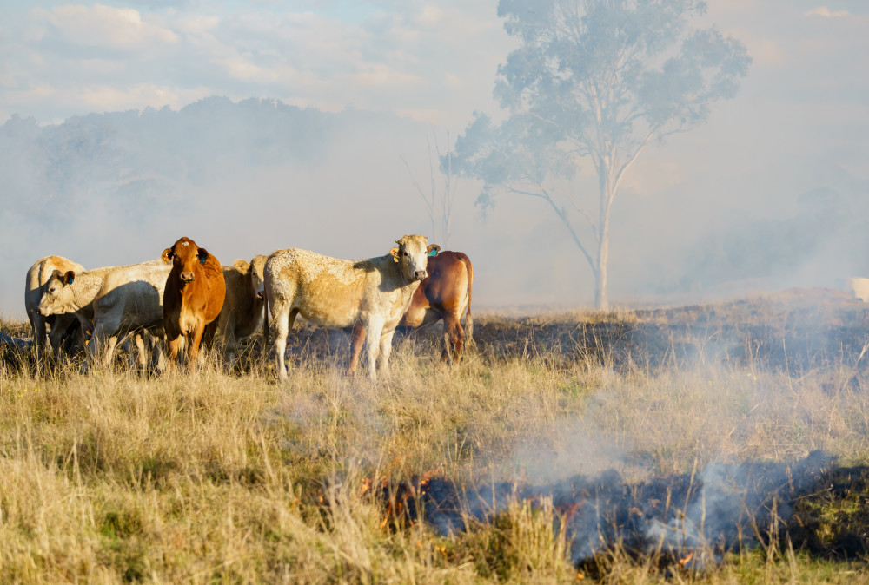
Feature #5 - Kojo - tools and equipments
Functional Requirements
Task Scheduling: for farmers (alerts and notifications)
Equipment Maintenance - electronic vehicle and tool maintenance log
Equipment Stock management (keep track of how many tools)
GPS Equipment Tracking (sensors on tools, where they are, missing tools alert/notifications)
Non- Functional Requirements: Data Security
Access Control
Data Encryption
Data Backups for things like disaster recovery

Slide 8
Feature #6 - Zain - sensors and data analysis tools
Functional
Temperature monitoring
Humidity monitoring
Offline Data Collection - redundant system that functions without an internet connection
Farm Analytics and Reporting (crop stats, livestock stats; amount produced, amount that died/didn’t grow properly)
Automatically tabulate crop statistics over time
Non Functional: Performance
Fast response times for real-time data and alerts
Optimized system backend
Conduct load testing to ensure the system can handle peak usage

Slide 9
Potential Challenges
Limited Experience in Agricultural Management
Data Accuracy and Integration: Ensuring that data from various sources (sensors, automated equipment) is accurate and effectively integrated into the system
Security and Privacy Concerns: Safeguarding user data and ensuring robust security protocols can be challenging.
Scalability: Handling complex, robust data while maintaining performance could be expensive with less engineers.

Slide 10

Strategies to Overcome Potential Challenges
Thorough research to gain domain knowledge
Employing a modular system design
Use updated information, do in-depth testing
Consult security/privacy professionals

Slide 11
Questions?

